Slide 1

Learning Analytics Spotting an At-Risk Student in Time

Slide 2
Assessment Date, Credit and Score should form Spotting Strategy while IMD Band, Highest Education Level, Region, Gender and Previous Attempts should form Mitigation Targets
Spotting Strategy
Mitigation Strategy
Assessment Dates
Check Assessment Dates
19, 24, 34, 49, 54, 69
Student Credit
Highlight Assessments with Highest Credits
Student Score
Check Students with Scores Lower than 72
Support
IMD 10-20% Students,
IMD 30-40% Students,
Students with Highest Education Lower than A Level
Students with Highest Education HE Qualification
Students from South West Region
Male Students
Students with Previous Attempts for Class
Notes:
Assessment Date, Credit and Score should form Spotting Strategy while IMD Band, Highest Education Level, Region, Gender and Previous Attempts should form Mitigation Targets.
My primary audience are university administrators and academic leaders responsible for student retention and student support.

Slide 3

Pace of Learning and Increased Autonomy Expose Students to Risk of Being Left Behind in Classes
Notes:
The structure of learning at university is characterized by: A fast-paced learning system & High levels of student autonomy.
The problem isn't simply that university education is difficult. Students have considerable independence while content moves quickly. A student who starts struggling can later fall behind before an instructor recognizes the problem.

Slide 4
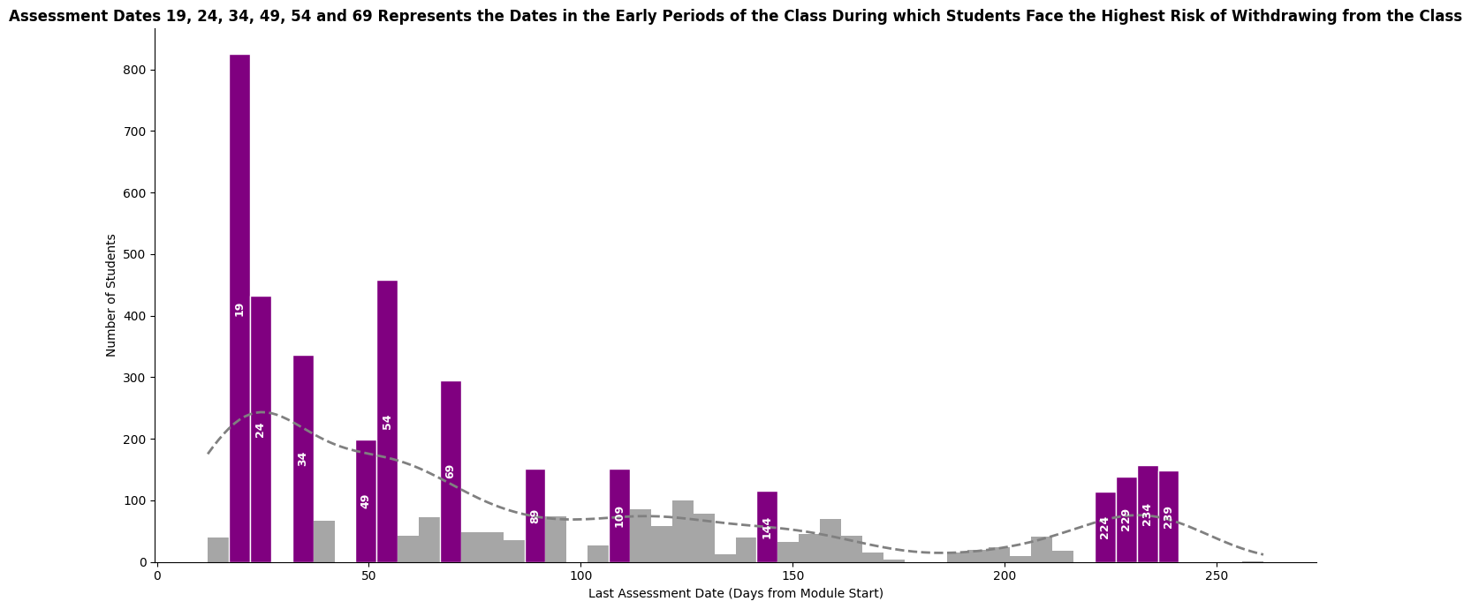
Notes:
The analysis presented in the visualization above focuses on students who ultimately 'Withdrawn' from their courses. By identifying their last recorded assessment date, information into when students are most likely to drop out is provided.
The peaks in this histogram pinpoint specific periods when a higher number of withdrawn students submitted their final assessment before formally dropping out. For early periods in the class, the peaks are noted for the following assessment dates; 19, 24, 34, 49, 54 and 69.

Slide 5
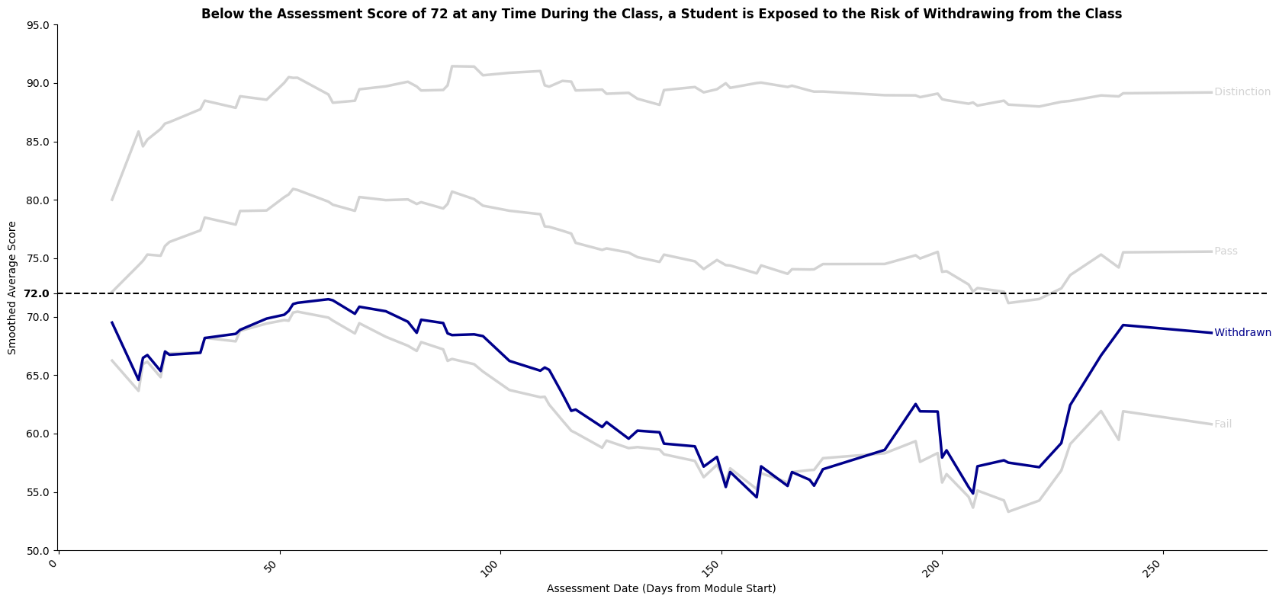
Notes:
Assessment performance, The line plot shows the smoothed average assessment score trend over date for all final_result categories, with the 'Withdrawn' trend line highlighted in blue. The prominent blue 'Withdrawn' line vividly illustrates that these students frequently maintain a lower average score throughout the module or experience significant, sustained declines early on. Notably, an assessment score of 72 serves as a consistent threshold across assessments below which a student has a higher exposure to the risk of withdrawing from a class.

Slide 6


How to Spot and Save At Risk Students in Time Makes the Difference in Student’s Progression with the Class
University administrations hence need to find a way of both identifying an at-risk student and provide mitigating assistance to prevent the student from dropping out of the course.
Notes:
Instructors are tied up with the fast-paced learning system and maintaining the high levels of student autonomy; both of which are outside the control of the instructors.
Rather then changing the system , the university should identify risk earlier and provide targeted support.

Slide 7
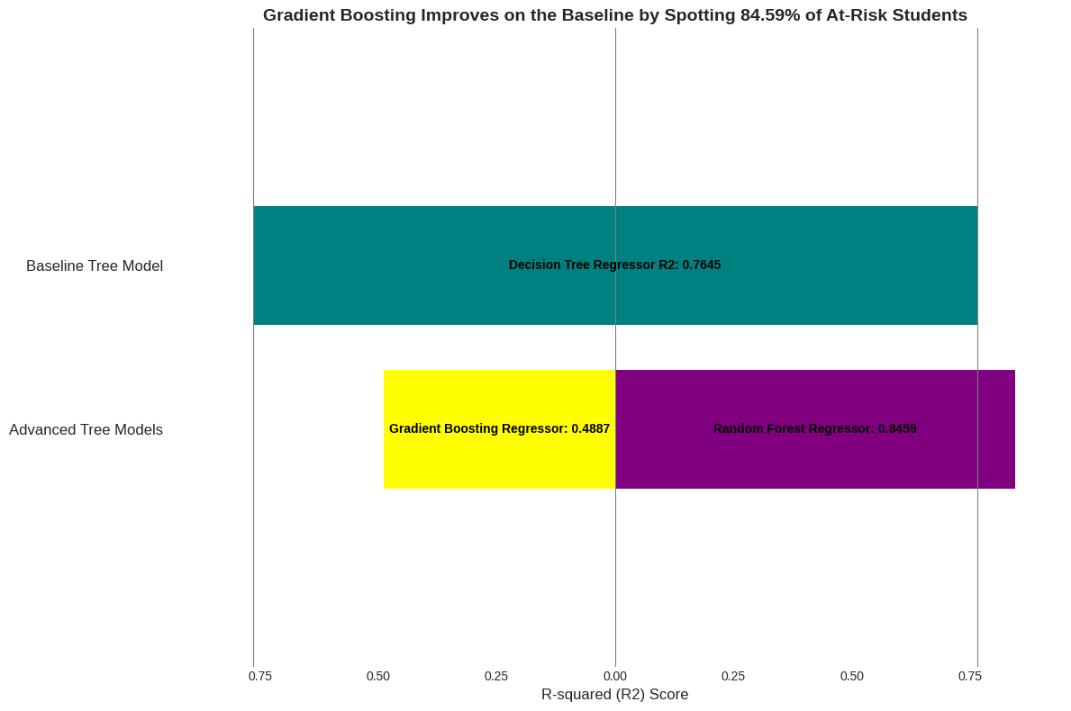
Random Forest Provides the Strongest Prediction of Student Withdrawal Risk
Notes:
Model comparison. The baseline tree model, a Decision Tree Classifier, had a 76.45% accuracy in spotting students at risk of withdrawing from the class.
The Gradient Boosting Regressor fell below the baseline with the model having 27.58% less accuracy in spotting students at risk of withdrawing from the class.
In comparison, the Random Forest Regressor, outperformed the baseline by having an 84.59% accuracy in spotting an at risk student, an 8.14% improvement in accuracy.

Slide 8
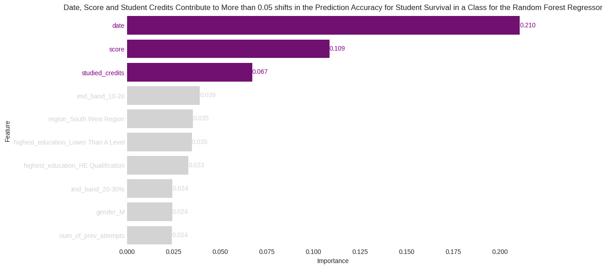
Notes:
Feature Importance , With the highest importance, the date is the most critical feature. This suggests that the timing of assessments or student activity relative to the module timeline is a primary driver of how long students 'survive' before withdrawing.
The score on assessments is the second most important feature. Students performing well are likely to remain engaged longer, while consistently low scores might precede withdrawal.
The number of studied_credits is also highly influential. This could reflect a student's workload, commitment, or academic capacity, all of which might impact their persistence in a module.

Slide 9
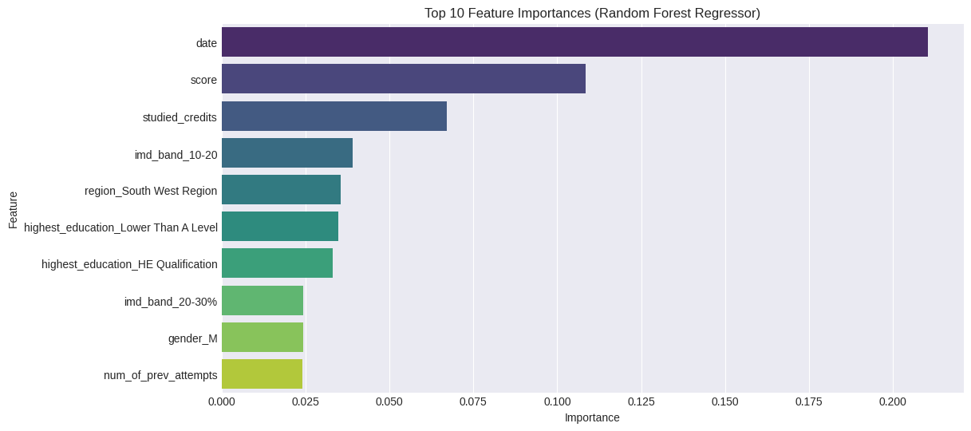
Index of Multiple Deprivation, Highest Education Levels, Region, Gender and Number of Previous Attempts can also Differentiate Withdrawal Patterns.
Notes:
Student Characteristics , Several features (highest education , number of previous attempts, imd band, region and gender) also appear in the top importances, that withdrawal patterns are also associated with student background characteristics. Factors such as socioeconomic status represented by IMD band, previous education, region, gender, and previous attempts appeared as important features. These factors can help us better understand an already identified at-risk student and potentially provide more targeted support.

Slide 10
The Strategy for Spotting At-Risk Student Should Involve Checking Student Performances for Assessment Date 19, 24, 34, 49, 54 and 69 and Assessments with High Student Credits, and Students Scoring lower than 72 across all Assessments
Spotting Strategy
Assessment Dates
Check Assessment Dates
19, 24, 34, 49, 54, 69
Student Credit
Highlight Assessments with Highest Credits
Student Score
Check Students with Scores Lower than 72
Notes:
At-Risk Students can be identified 84.59% of the time when for assessment dates 19, 24, 34, 49 , 54 or 69 the score for the tasks with highest credits fall below 72.

Slide 11
Mitigation Support need to be based on the IMD Band, Highest Education Level, Region, Gender and Status on Previous Attempts for the At-Risk Students
Mitigation Strategy
Support
IMD 10-20% Students,
IMD 30-40% Students,
Students with Highest Education Lower than A Level
Students with Highest Education HE Qualification
Students from South West Region
Male Students
Students with Previous Attempts for Class
Notes:
Mitigation should offer:
Financing advice and option for IMD 10-20% Students, and IMD 30-40% Students,
And class work support for Students with Highest Education Lower than A Level, Students with Highest Education HE Qualification, Students from South West Region, Male Students and Students with Previous Attempts for Class

Slide 12
The Study has Generalizability Limitations and, Limitations in terms of Inferred rather than Direct Mitigation Recommendations and the Multifaceted Student Support Strategy.
Limits
Limited generalizability due to data being sourced only from OULAD
Study only allows for Inferred Recommendations for Mitigation
Multifaceted Student Support Strategy
Notes:
The data is the focus on a single educational institution, The Open University; which in turn limits generalizability of the data for all universities.
Another limitation is that the data does not contain direct intervention information with potential predictors offering inferred recommendations instead.
Additionally, the student support mechanism has 7 aspects capturing the different risks associated with student withdrawing from the class, outside assessment. For each aspect a specific approach would be needed making the support system multifaceted; the cost of having a multifaceted support strategy might be too high.

